Slide 1
Mini Project 1
LHL Data Science Oct. 25 2021 Cohort
Matthew John Coffey

Slide 2
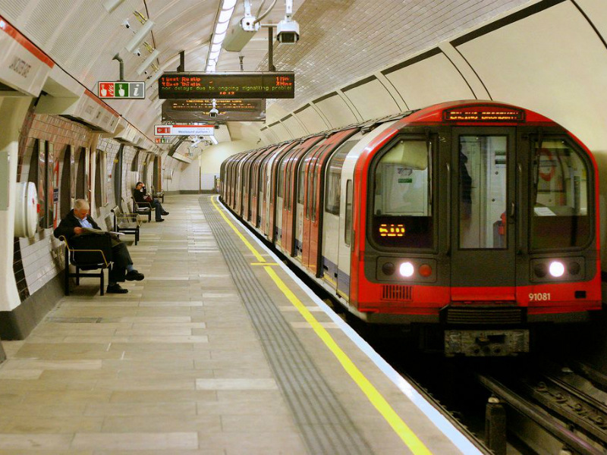
London Transportation Safety Analysis

Slide 3
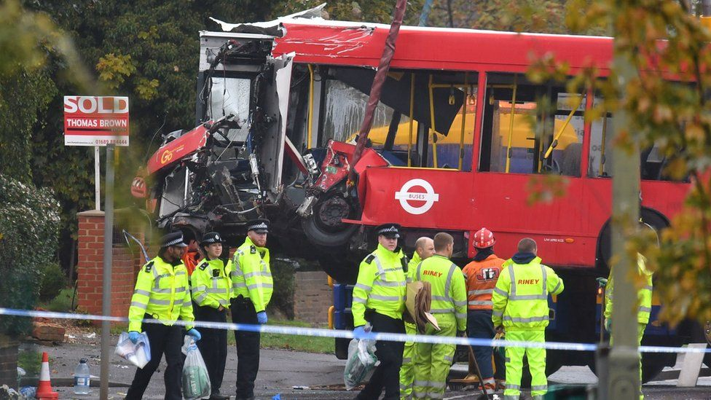
Motivation
As a rider and public transportation advocate, I’d like to know if transit is becoming more or less safe as related to accidents.

Slide 4
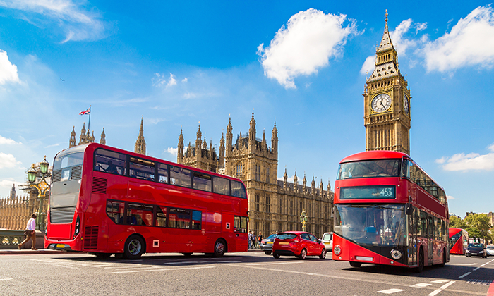
Task
Has the number of accidents on Transport for London increased or decreased?
How does that look when we break it down to fatal, severe, and slight accidents?

Slide 5
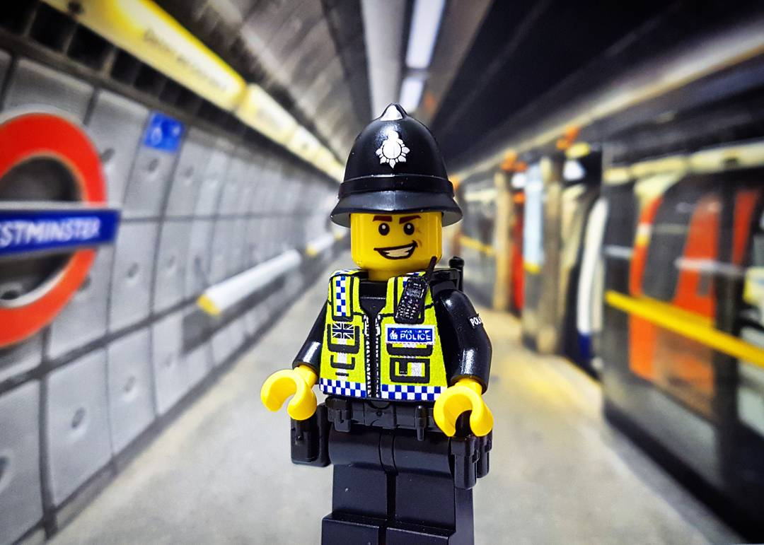
Modeling
Data from TfL isn’t available before 2005
Reporting procedures from police changed in 2016
We will examine events from 2005 - 2015, comparing total, fatal, severe, and slight accidents

Slide 6
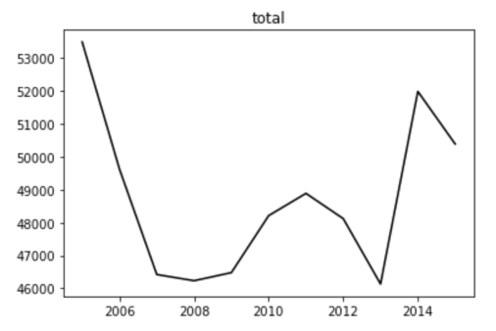
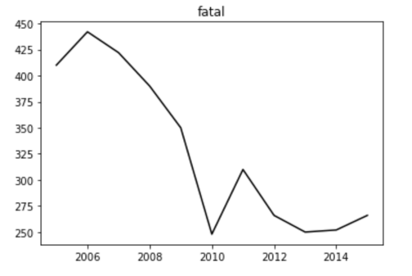
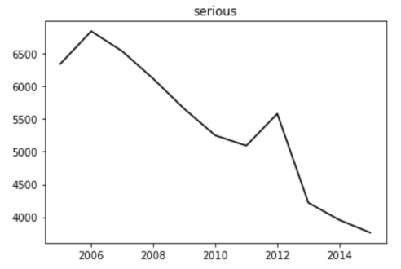
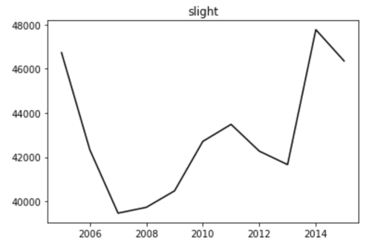
Results

Slide 7

Comparative Sentiment Review

Slide 8

Motivation
As an entertainment magazine journalist, it’s important to be able to quickly identify new trends in movies, tv, and famous people. I need a tool that will be able to tell me which trending items deserve more investigation.

Slide 9

Task
Find discrepancies between weekly and daily trending top 5s

Slide 10

Modeling
Find which items appear on the daily list, but not the weekly - these may be rising in sentiment and deserve further investigation.
Find which items appear on the weekly list, but not the daily - these may be declining in sentiment.

Slide 11
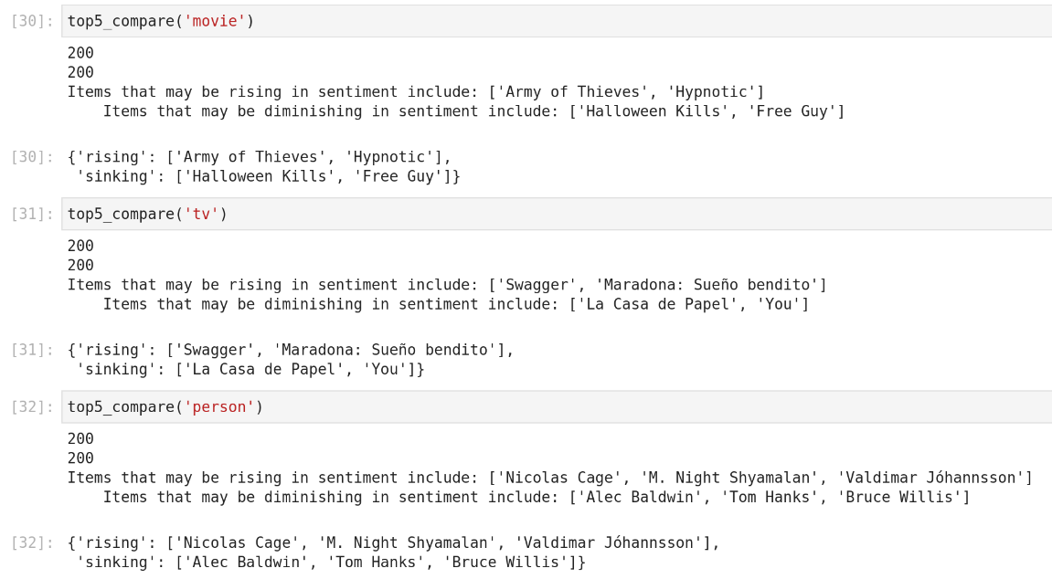
Results

